Slide 1
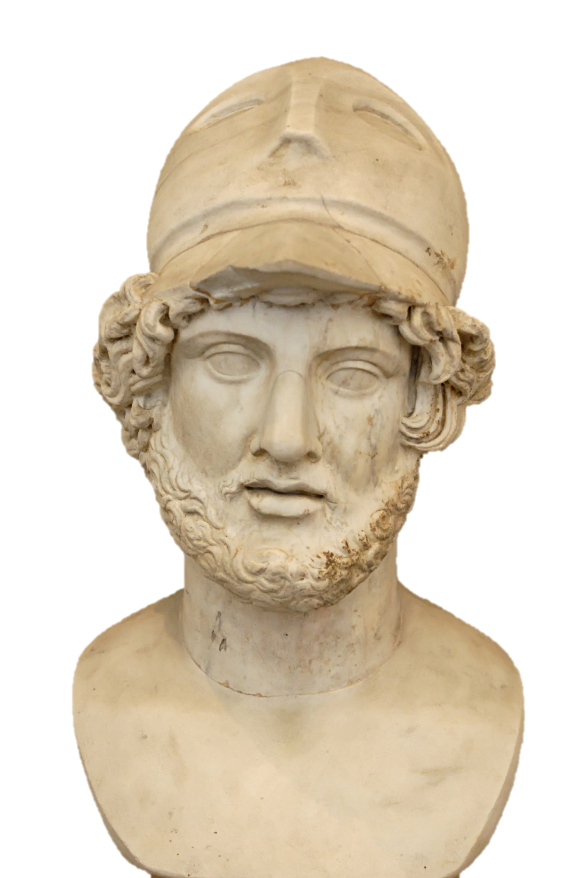
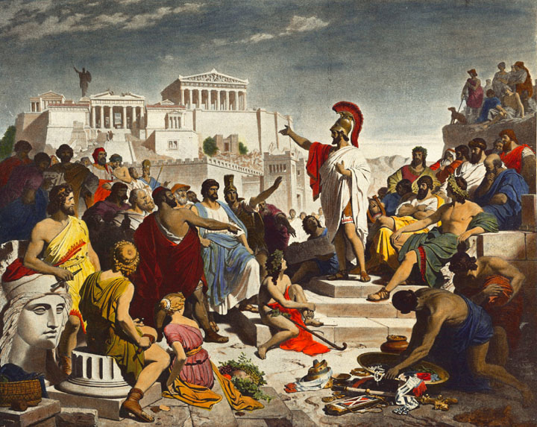
Athens vs. Sparta
Sparta:
1. _______ _______ (___ resources go into training ________).
2. __________ – the _____________ of military _____.
3. _______________ – government _________ ___ aspects of society: (______ government _______ =
no personal _______)
athens:
Idiotes!
1. Ancient ______ = 1st _________ in history!
______ Democracy – government in which
____ citizens participate ________ rather than
through _______ _______________.
3. _______ Democracy: Only ___ could ___________; not women or slaves.
________ – leader during Athens ___________
(civilization’s ____).

Slide 2
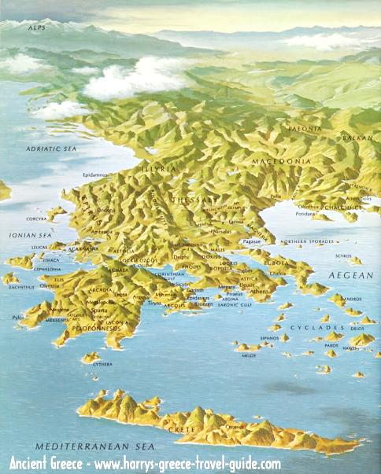
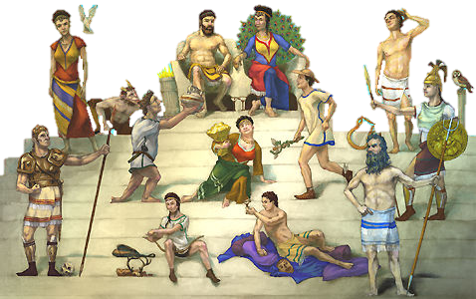
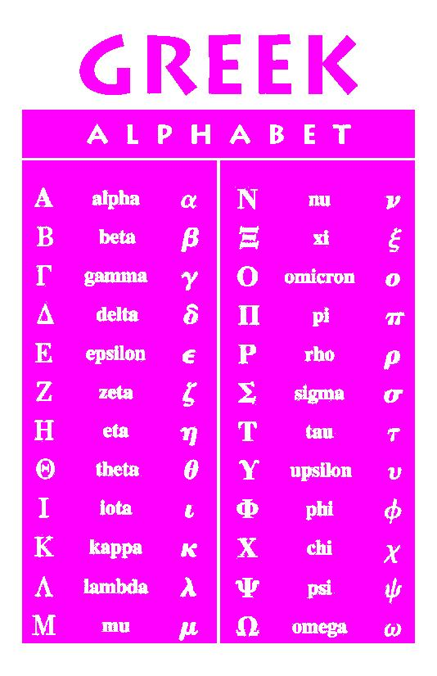
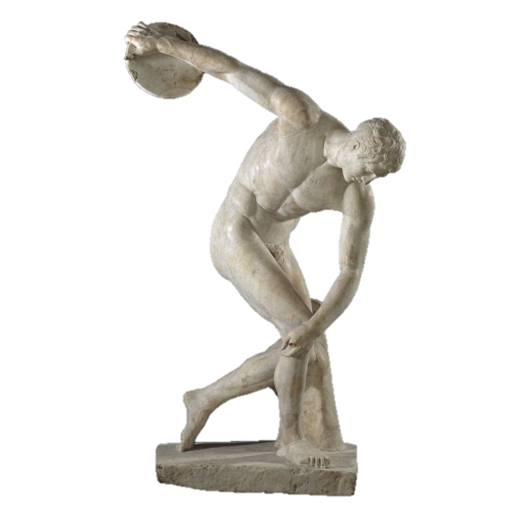
Greek “Cultural” unity
1.
2.
3.
4.

Slide 3
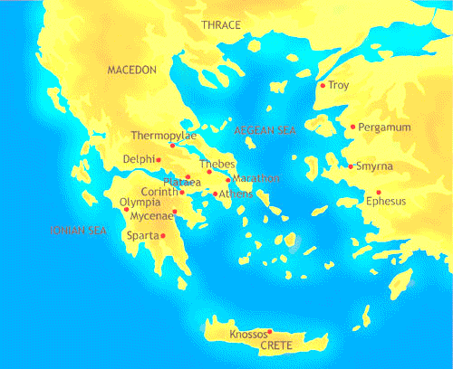
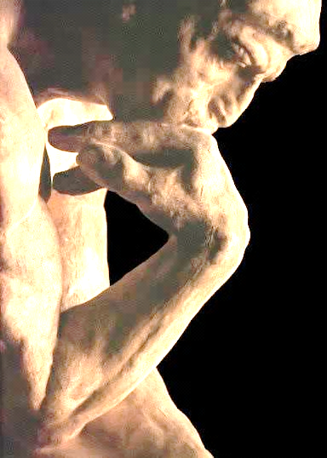
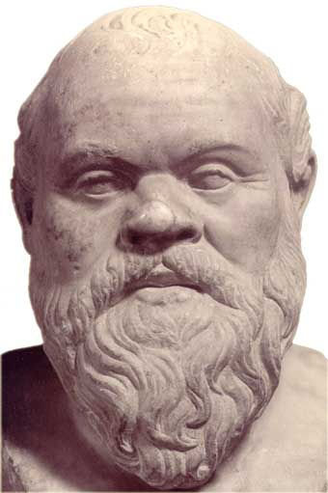
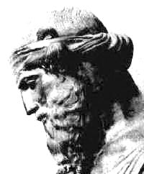
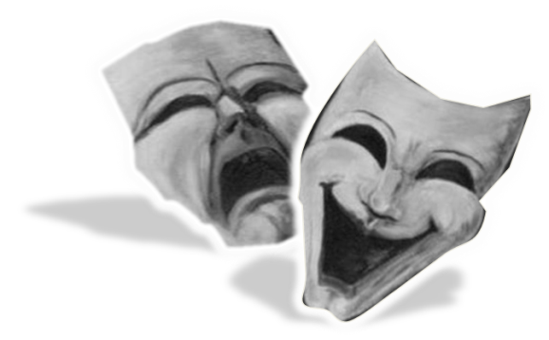
G0lden Age of athens
__________→ Greek ________ used ___________ & ______ to understand the _____ around them.
________ – focus on _______ rather than _________ subjects and the potential of the _____ ____.
Greek Philosophy:
1. Use _______ ___________ and ______ to seek the _____ (Socratic ______).
2. Tried and sentenced to _____ for promoting _______ _____ and challenging the government of Athens.
Socrates
The ______ and most ________ individuals should ____ society (anti-democratic).
Multifaceted ______ (symbolic of the spirit of ________).
Plato
Aristotle
Literature:
1. Theater, plays and the literary themes of _______ & ______.
2. _____ – Wrote the epic poems the _______ & the _____.

Slide 4
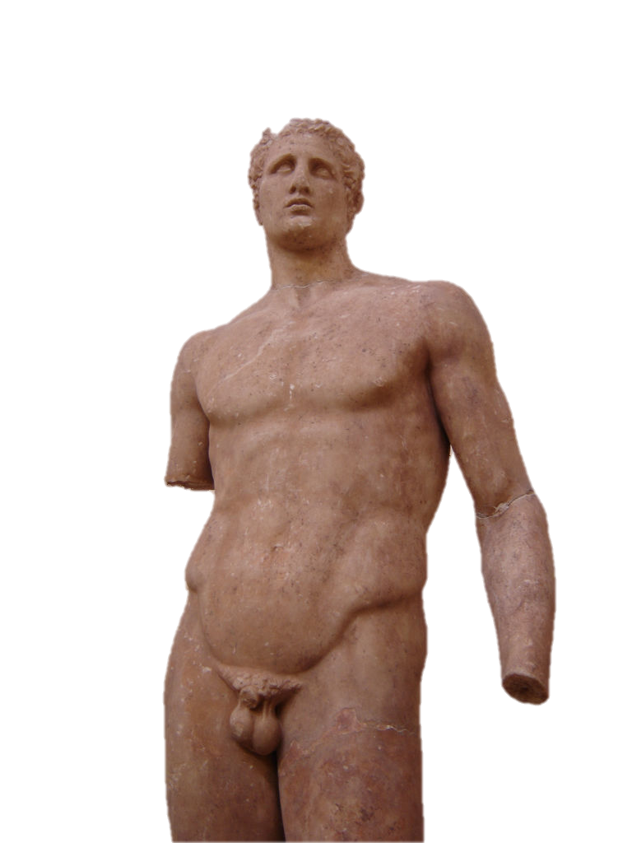
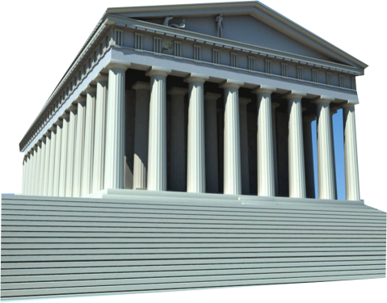
G0lden Age of athens
Art & architecture:
1. Desired ______ & _______ in their artwork.
2. ________ art – portray the ____ in _______ form.
3. _________ – most ______ Greek building

