Slide 3
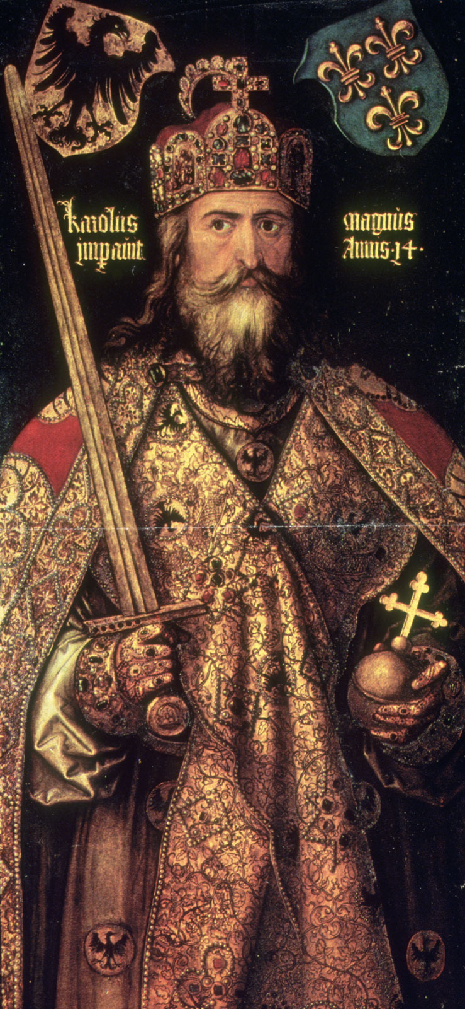
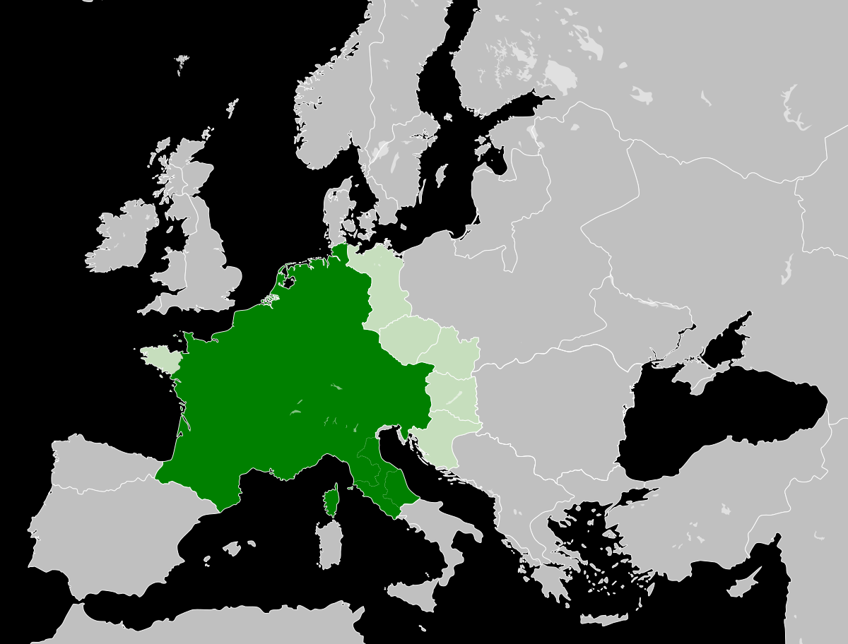
A semblance of political unity and cultural revival emerged under the Carolingian Dynasty of the Franks from about 751 to 814. The Carolingian kings gained and expanded their power through an
alliance with the Roman Catholic Church. The Pope crowned the first Carolingian King, Pepin, the “king by grace of God.” This act established a tradition that long endured in Europe in which the pope claimed
the right to confer secular political power on kings. Carolingian power reached its peak under Charlemagne who built an empire that spanned most of Central Europe. The pope re-enforced this power
by crowning Charlemagne the “Roman Emperor” in 800. Under Charlemagne, Europe briefly enjoyed a level of political unity that had been unseen since the fall of Rome. Charlemagne also fostered a modest intellectual revival by sponsoring the creation of schools. Weak leadership by Charlemagne’s heirs reversed much of this centralization and cultural revival and Europe became a largely feudal society in the
years after his death in 814.

Slide 5
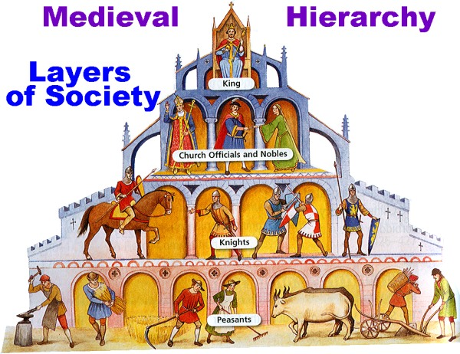

Slide 8
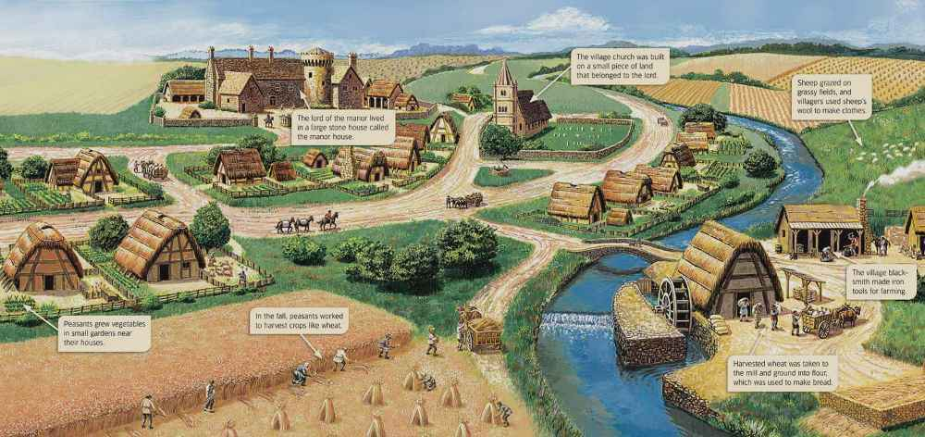

Slide 9
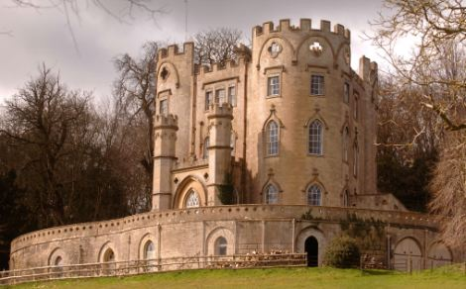

Slide 10
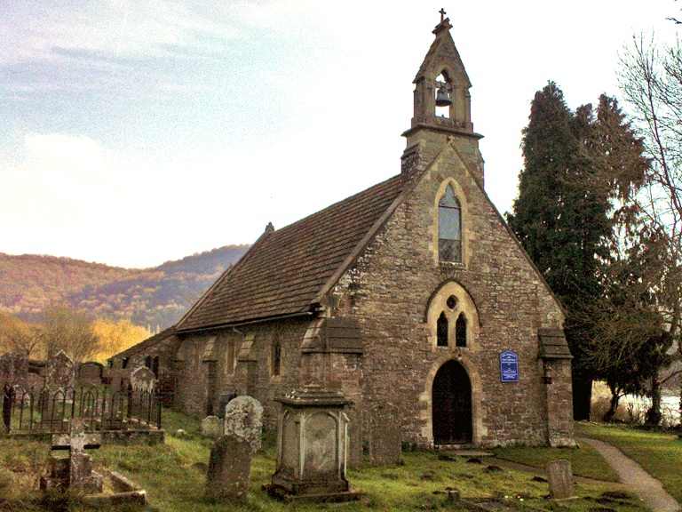

Slide 11
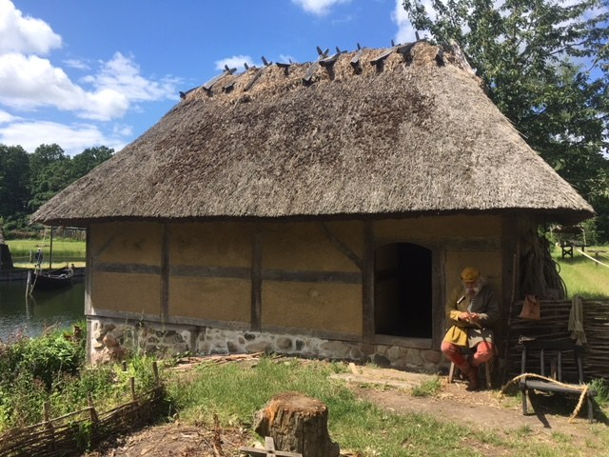

Slide 12
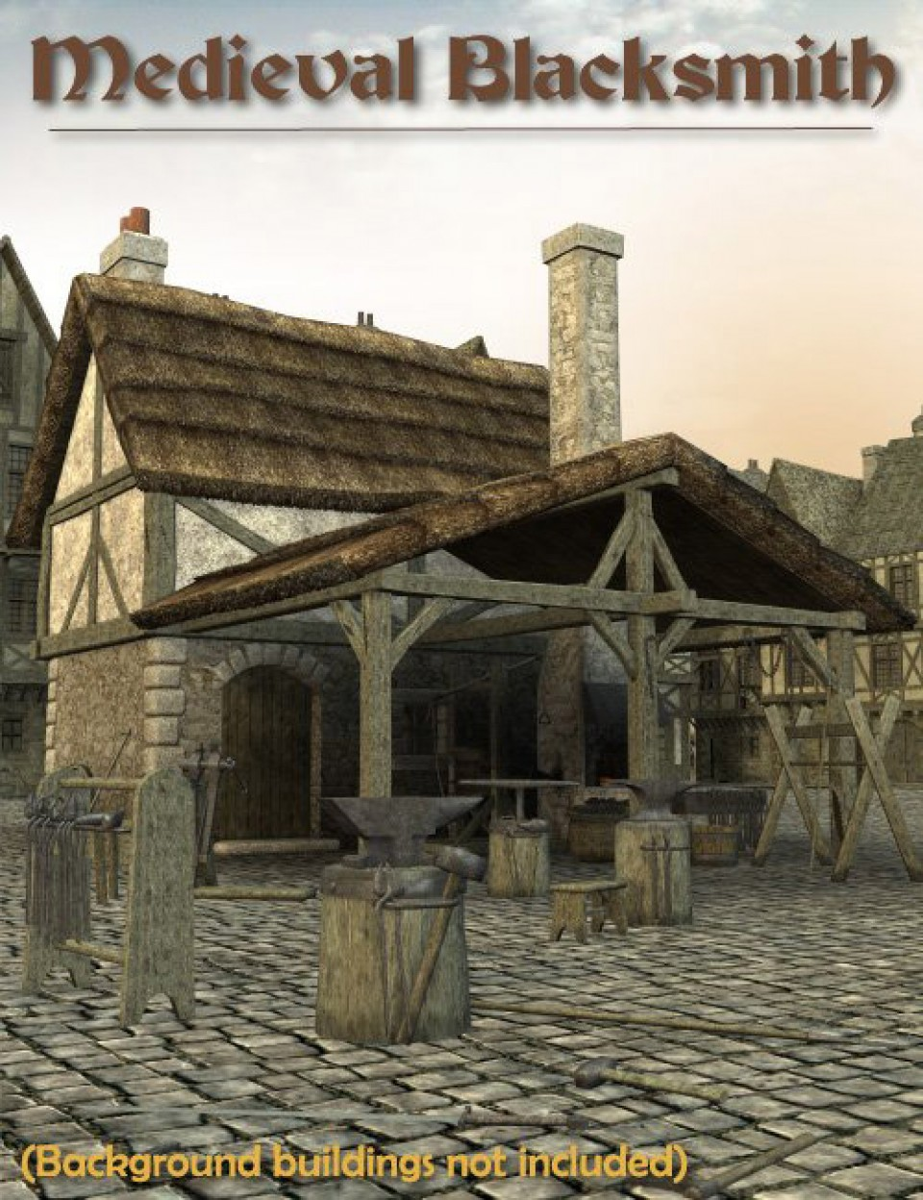
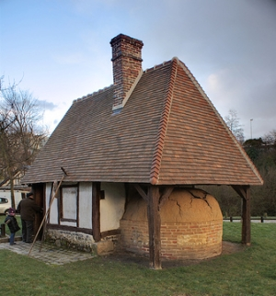
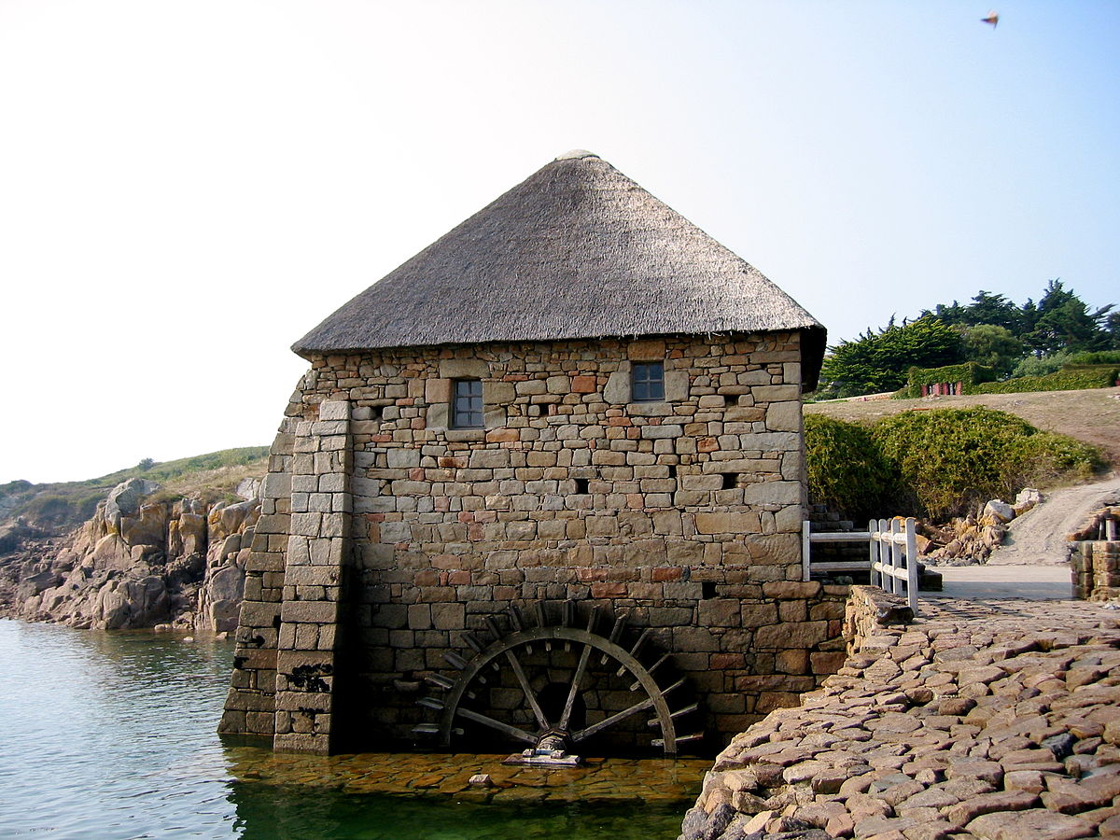

Slide 14
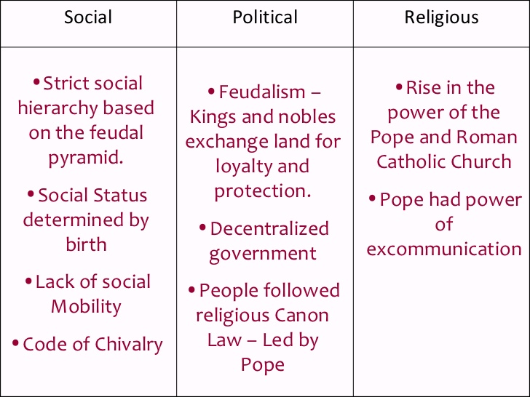

Slide 15
