Slide 1
Systems of Government

Slide 2
FEDERAL/CENTRAL
State
State
State
State

Slide 3
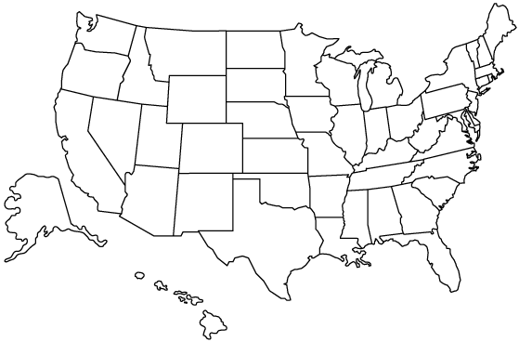
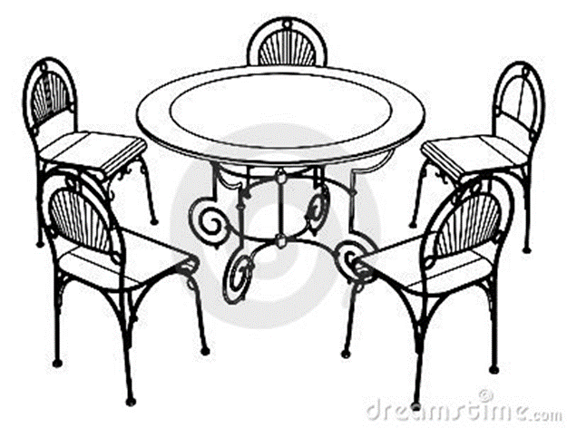
Federal system
Central government shares the power with the states
Think of it like Table and chairs
Chairs represent states and the table represents the Central government- They work together
states
Central
states
states
states
CENTRAL
STATES
STATES
STATES

Slide 4
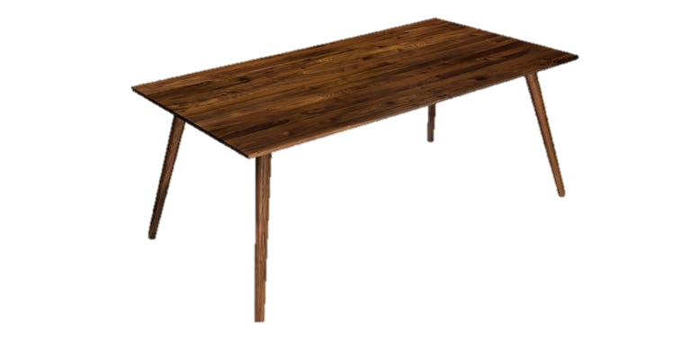
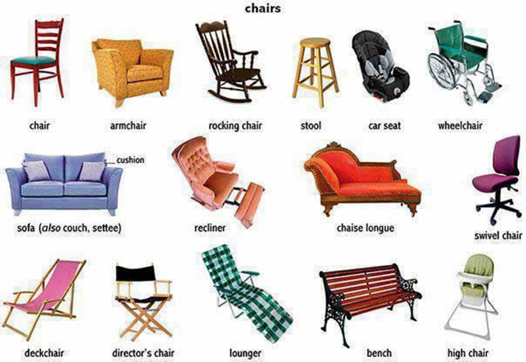
Confederal system
central
States have control of the government
Central government is usually present but has minimal power
Just different kinds
of chairs and a tiny table
STATES
STATES
STATES
STATES

Slide 5
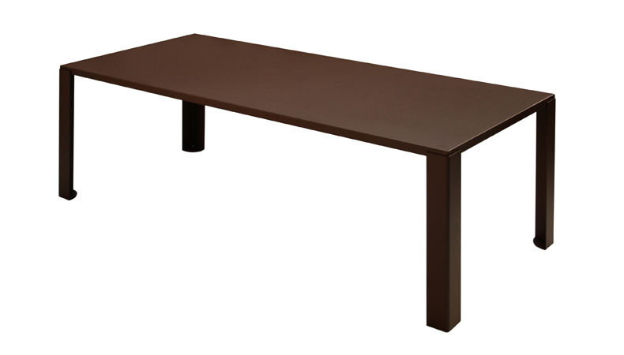
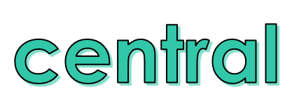
Unitary system
The central government is in charge of everything and does not share the power
One big table
Uni means one
No Chairs

