Slide 1

The Legislative Branch:
SSCG8: Demonstrate knowledge of the legislative branch of government.
SSCG8a: Cite the formal qualifications for representatives and senators listed in the Constitution.

Slide 2

Types of Qualifications
Formal Qualifications: A qualification that is explicitly stated in the Constitution.
Informal Qualification: A qualification that is NOT explicitly stated in the Constitution. Qualifications that are usually suggested from a social expectation.

Slide 3

American Bicameralism
The Legislative Branch is comprised of a Bicameral Legislature, Congress.
Congress is divided into 2 Houses, House of Representatives, Lower House and the Senate, Upper House.

Slide 4

Qualifications for the House of Representatives
There are 435 members in the House of Representatives. Determined by states population.
There are three formal qualifications outlined in the United States’ Constitution, which says that a member of the House:
1) must be at least 25 years of age.
2) must have been a United States citizen for at least seven years.
3) must be an inhabitant of the State from which he or she is elected.

Slide 5

Qualifications for the senate
There are 100 members in the Senate. There are two members for each of the fifty states.
A senator must meet a higher level of qualifications, as outlined in the Constitution:
1) a senator must be at least 30 years of age.
2) must have been a citizen of the United States for at least nine years.
3) must be an inhabitant, occupy a residence, of the State from which he or she is elected.

Slide 6
What privileges and compensations does a member of Congress get?
Members of Congress get the following “perks:
Salary ($174,000 per year), The Speaker of the House of Representatives receives a salary of $223,500, while all other leadership positions pay $193,400.
Medical and dental benefits, access to federal retirement plans
MRA (Member Representational Allowance) - staff, travel, mail, office equipment, district office rental, stationery, and other office supplies.
Requires long hours, a lot of time away from family, and pressure from others to support their policies (CONS)

Slide 7
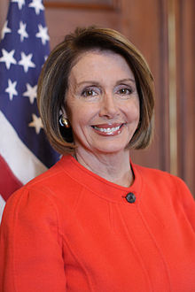
Congressional leadership: Speaker of the House
Nancy Pelsoi
Most important person in Congress
Presides over House
Makes committee assignments
Appoints party’s legislative leaders
Exercises substantial control over which bills get assigned to which committees
This Photo by Unknown Author is licensed under CC BY-SA

Slide 8
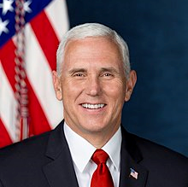
President of the Senate
Vice - president: Mike Pence
Holds tie-breaking vote in the
Senate
Presides over the Senate

Slide 9
The Legislative Branch:
SSCG8: Demonstrate knowledge of the legislative branch of government.
SSCG8b: Describe the election process for representatives and senators and how the 17th amendment impacted the election of senators.

Slide 10
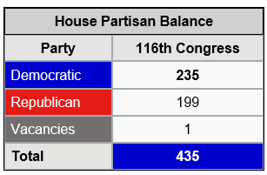
Congressional elections
Congressional elections are held on the same day in every state.
For the House of Representatives, elections are held on the Tuesday following the first Monday in November of each even-numbered year.
The congressional elections that are held in nonpresidential election years are referred to as off-year elections.
ALL House of Representative members must run for election or re-election every two years.

Slide 11
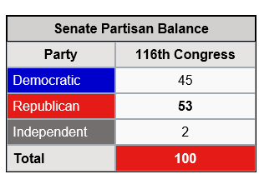
Congressional elections
The senate is referred to as a continuous body, which means that all of the seats are never up for election at the same time.
Only one-third of the senators run for election every two years.
Since a senator has a six-year term, only 33 to 34 senators run for election or re-election every two years.
https://www.politico.com/interactives/2018/interactive_116th-congress-freshman-younger-bluer-diverse/

Slide 12
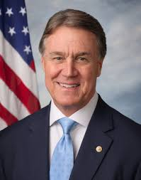


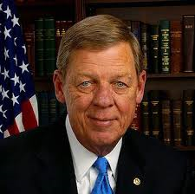
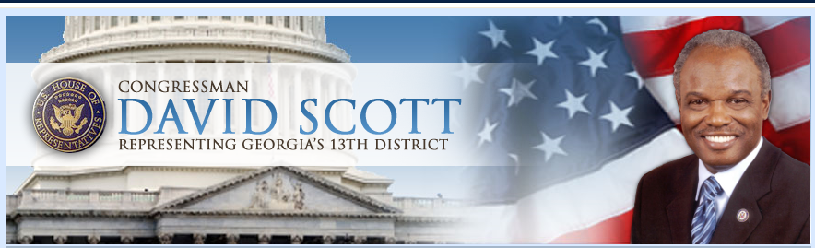
The impact of the 17th amendment
Originally, senators were elected by the state legislatures; they were elected in this manner for the first 125 years following the passing of the U.S. Constitution.
The 17th amendment was passed in 1913. The ratification of the 17th amendment placed the election of senators in the hands of the American citizens. After 1913, both senators and representatives were elected by the people.
How is the election of senators and representatives different from the election of the President? Should it be the same.....?

Slide 13
crash course:
Congressional Leadership
https://www.youtube.com/watch?v=L8urcMLGFyU&t=20s

Slide 14
The Legislative Branch:
SSCG8: Demonstrate knowledge of the legislative branch of government.
SSCG8c: Compare the terms of office for each chamber of Congress and explain the Founder’s intent.

Slide 15
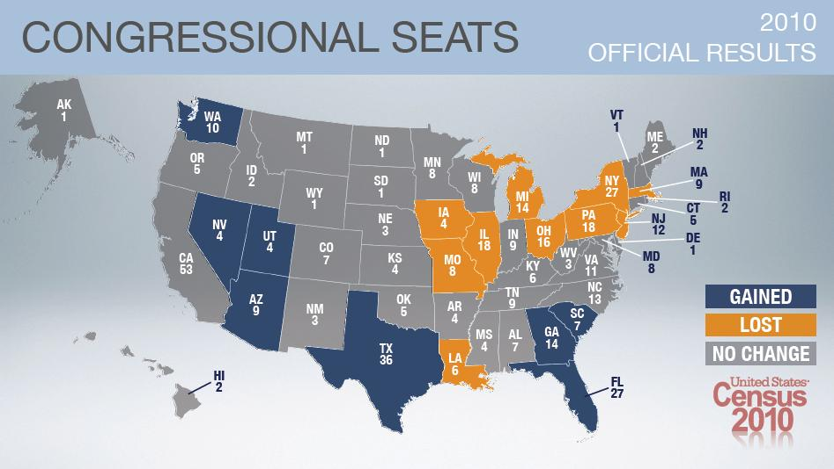
House of Representatives
The current size of the House of Representatives is 435 members. This number is not set in the Constitution, rather Congress decides on the number of members in the House.
The Constitution does provide that the seats in the House of Representatives shall be apportioned, or distributed, among the states based on their populations.
Each state is guaranteed at least one House member.

Slide 16
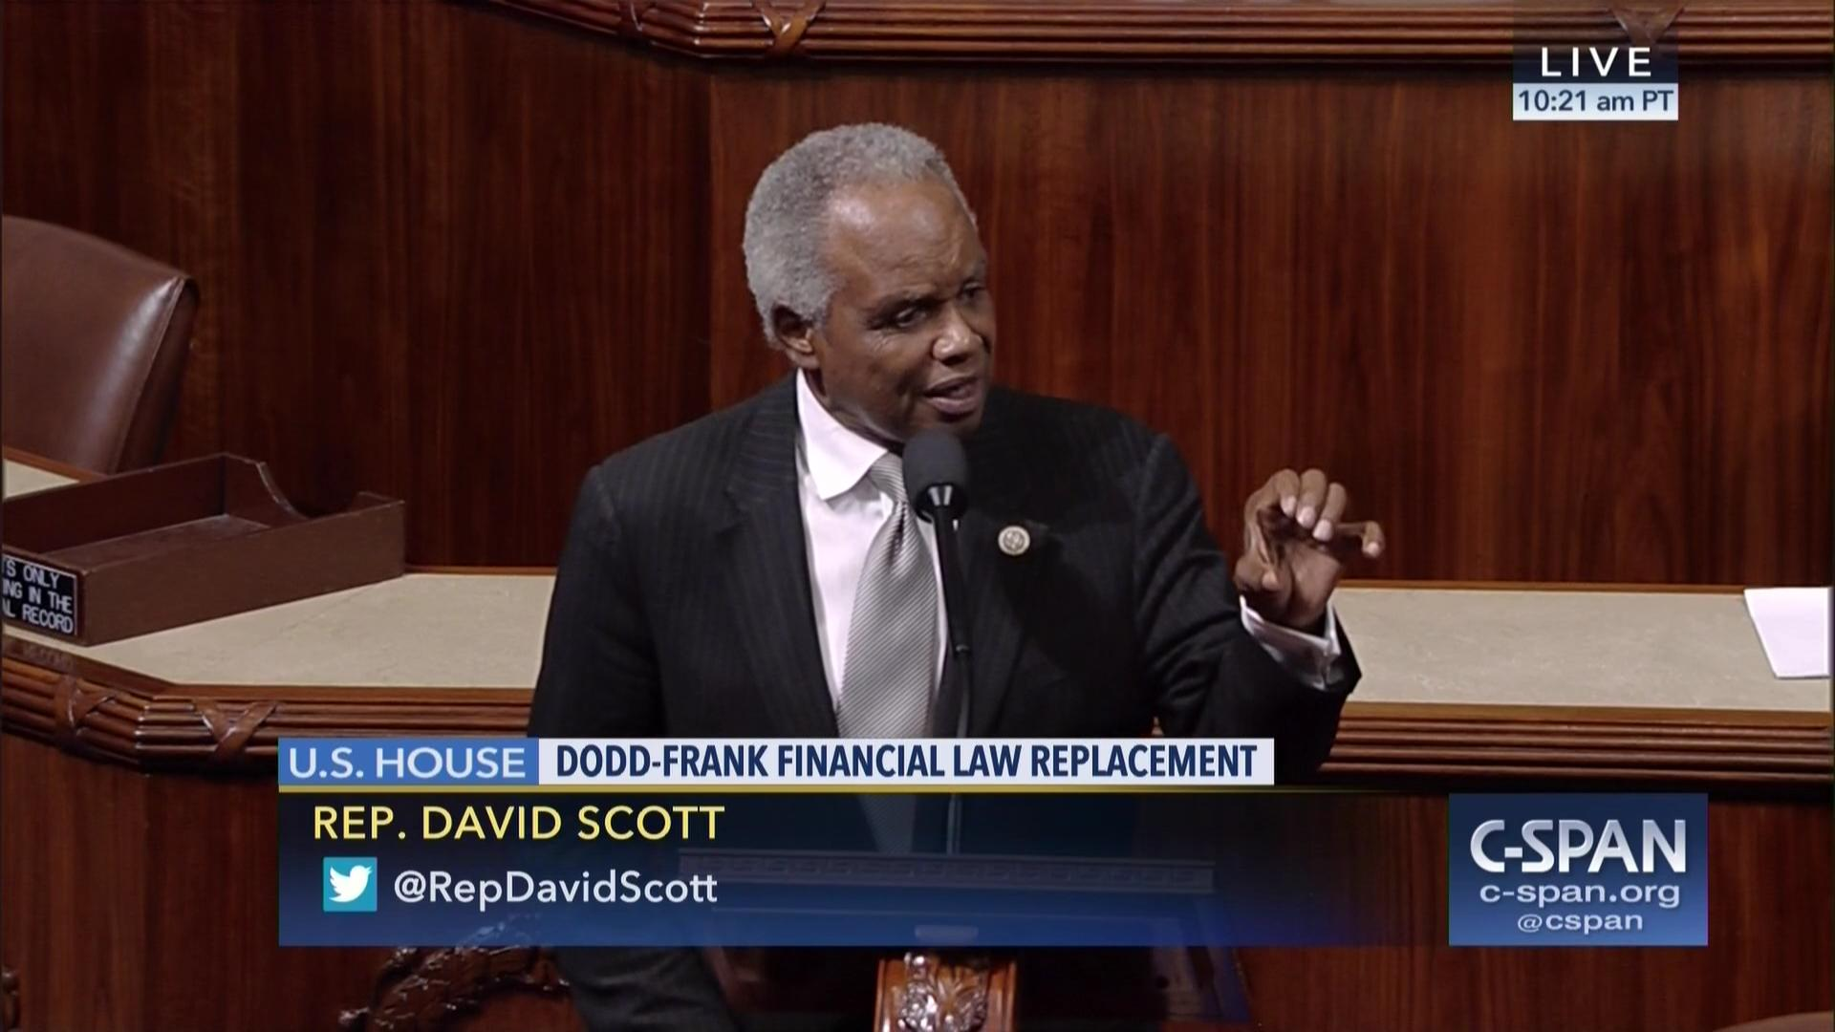
House of Representatives
The members are elected by registered voters in the district in which they represent.
They have the advantage of having a smaller constituency, which includes the people and interests each House member represents.
This provides an opportunity for representatives to be more involved and aware of issues that are important to the voters in their particular district.

Slide 17

House of Representatives
The seats in the House may be reapportioned, or redistributed, based on the results of the census, which is conducted every ten years. Some states may gain a representative(s), while some may lose; the number of the membership remains at 435.
All of the 435 members in the House have a two-year term, and there are no term limits.
https://www.census.gov/2020census

Slide 18
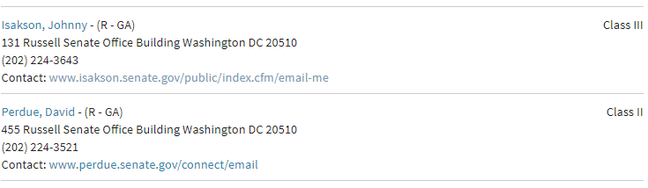

Senate
The current size of the Senate is 100 members. Each state is represented by two senators.
Senators are elected state-wide and represent all of the constituents in their state. Senators serve a six-year term, and as in the House, there are no term limits.
This six-year terms gives senators a greater degree of job security. Senators are supposed to be more focused on the bigger picture of the needs and interests of their state as a whole, versus need and interests of individual districts within the state.

Slide 19
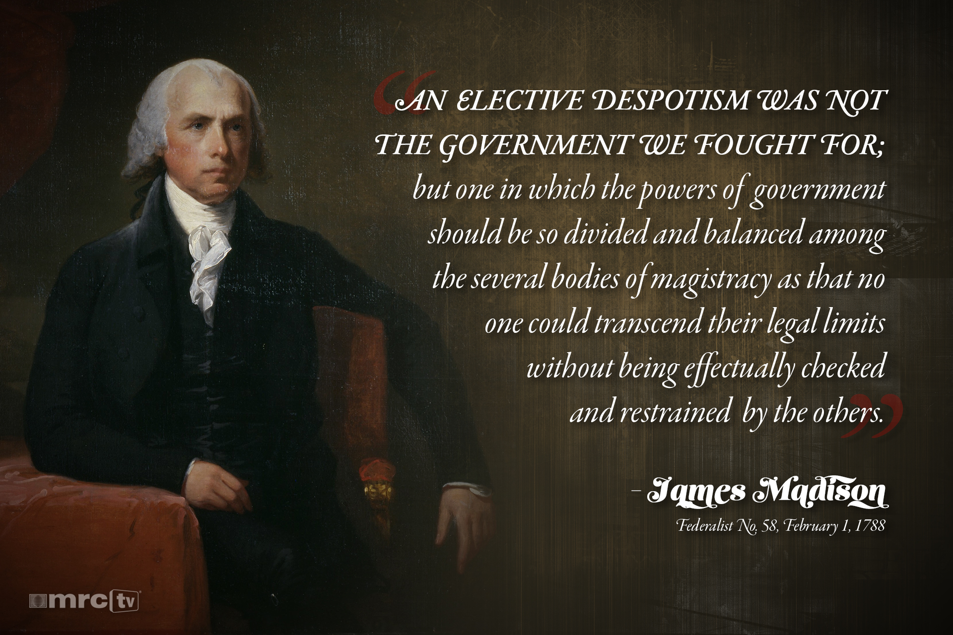
Founding Father’s Intent
The intent of the Founders was to design a bicameral legislature, or a legislature with two houses. There are three reasons that the founders preferred the bicameral structure.
Founders were familiar with the design of the British Parliament, which had two houses.
The bicameral design of two houses solved this conflict between the Virginia Plan and New Jersey Plan.
this bicameral design would allow for a system of checks between both houses.

Slide 20
The Legislative Branch:
.
SSCG8: Demonstrate knowledge of the legislative branch of government
SSCG8d: Compare and contrast the powers of each chamber of Congress (e.g., power of the purse, 16th amendment, treaties, etc.

Slide 21

Powers that Belong to the House of representatives
The House of Representatives has several powers assigned exclusively to it, including the power to initiate revenue bills, impeach federal officials, and elect the President in the event of an Electoral College tie. The power of the purse is another term for the initiation of revenue bills. ALL revenue bills must originate in the House.

Slide 22

Powers that Belong to the House of representatives
The majority of revenue is collected through taxation. A tax is a charge levied by the government on personal income, corporate income, or property. The 16th amendment to the Constitution gives Congress the power to levy income taxes without apportioning it among the states or basing it on the U.S. census.

Slide 23

Senate Powers
The Senate has several powers assigned exclusively to it by the Constitution including the sole power to confirm Presidential appointments, ratify treaties, elect the Vice-President in the event of an electoral tie, and try cases of the impeachment of federal officials.

Slide 25
The Legislative Branch:
SSCG8: Demonstrate knowledge of the legislative branch of government.
SSCG8e: Explain the steps in the legislative process.

Slide 26
If the bill begins in the House….
1. The bill is drafted (anyone can draft a bill – members of Congress, the President, outside groups)
2. Introduced in the House - a House of Representatives member introduces the bill (only members of the House or Senate can introduce bills).
3. The Speaker of the House sends the bill to a committee.
4. Committee Action – most bills die here, but if the bill is passed, it goes to the Rules Committee.
5. Rules Committee – the bill is assigned a time for debate in the House (only the House has a Rules Committee).

Slide 27
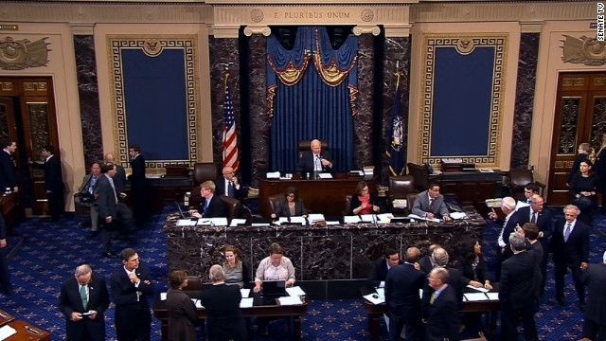
If the bill begins in the House….
6. Floor Action – the bill is debated, and amended, if necessary. If a majority of House members approve the bill, it goes to the Senate.

Slide 28
If the Bill is introduced in the senate:
1. Introduced in the Senate – a senator introduces the bill, and the bill is assigned to a committee.
2. Committee Action – if the committee majority votes for the bill, it goes for debate in the Senate as a whole.
3. Bill Called Up – the Senate Majority Floor Leader decides when the bill will go up for debate.
4. Floor Action – the bill is debated, and amendments may be made. If the bill passes the Senate with a majority vote, it is sent back to the House.
5. Conference Committee – if the House rejects any changes made by the Senate, it goes to a conference committee, which is comprised of members from both the House and the Senate. They work out a compromise.
6. Vote on Compromise – both the House and the Senate must approve the bill as amended by the conference committee. If approved by a majority vote in both houses of Congress, the bill is sent to the President.

Slide 29
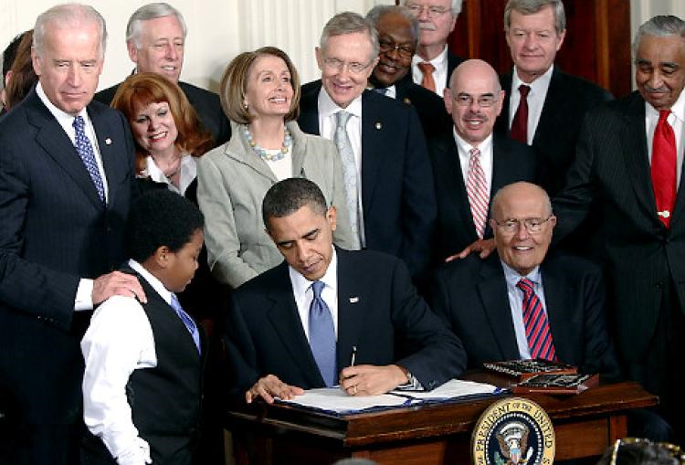
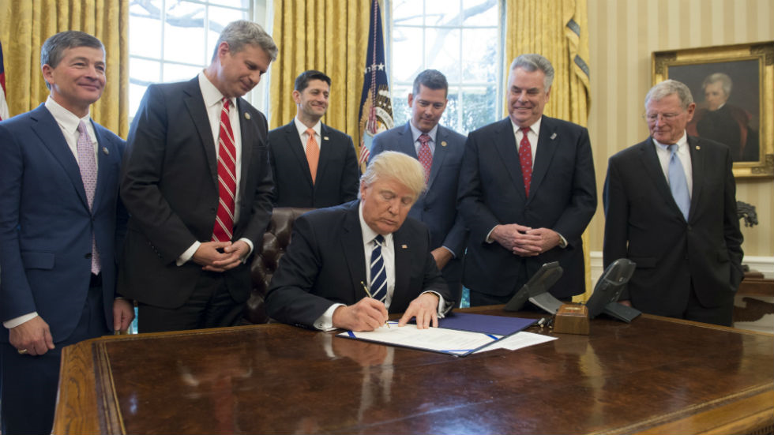
Closing the deal!
1. Presidential Action – the President may sign, or approve, the bill or veto (reject) the bill. If the President signs the bill, becomes law.
2. Vote to Override – if the President vetoes the bill, it can still be approved by a two-thirds majority in both houses to become law.

Slide 30
Key Vocabulary for the Legislative Process
Rider – a provision not likely to pass on its own merit that is attached to a bill that is certain to pass.
Discharge petition – this petition enables members of either house to force a bill that has remained in committee for 30 days or longer onto the floor for consideration.
Quorum – a majority of the membership that must be present in chambers to conduct business.
Engrossed – the bill is engrossed when it is printed in its’ final form.
Filibuster – essentially this is the attempt to ‘talk a bill to death’. It is a stalling tactic that is used by a minority of senators seeks to delay or prevent Senate action on a matter. A filibuster can ONLY be used in the Senate.
Cloture – a Senate rule used to limit debate. At least three-fifths of the senate, or 60 members, must vote to invoke cloture.
Veto – when the President refused to sign a bill into law.
Pocket veto – if Congress adjourns its’ session within ten days of submitting a bill to the President, and the President does not act, the bill dies.

Slide 31
How a Bill becomes a Law
House of Representatives
Senate
Bill is introduced
Bill is sent to Senate committee for review.
Committee returns bill to Senate for vote, revises it and returns it, or does not send it back (tables it).
Senate votes. If bill passes, it goes to House committee
House committee sends bill to House for vote, revises it and sends it to House, or tables it.
Bill is introduced
Bill is sent to House committee for review.
Committee returns bill to House for vote, revises it and returns it, or does not send it back (tables it).
House votes. If bill passes, it goes to Senate committee
Senate committee sends bill to Senate for vote, revises it and sends it to Senate, or tables it.
If a bill is approved, it is reviewed by a committee made up of members from both chambers
Revised bill goes to both chambers for vote
If bill passes, it is sent to the president
Congress can override veto by two-third vote
President signs bill- bill becomes law, President vetoes bill-

Slide 32

How a Bill Becomes a Law: Road Map
Use the Flow-Chart and Notes from class today and create a visual describing How a Bill becomes a Law.

Slide 33
Research a bill
Research a Bill:
Urge your students to learn about a real bill that they might know, whether that is a historic civil rights law or a local bill creating a road or national park. Students can use Congress.gov to research bills by topic, sponsors and lawmaker. They can also look up bills that are stuck or died on the way to the president’s desk.
You will research and list the following information:
What the Bill would do
The Sponsor(s) of the bill
Committees involved
Latest Action
Tracker

Slide 34
Legislative branch
SSCG8f: Explain the functions of various leadership positions and committees within the legislature.

Slide 35
SPEAKER OF THE HOUSE
The Speaker of the House is the most important position in Congress. The Speaker is the elected, presiding officer of the House of Representatives. The Speaker is chosen from the majority party in the House and is typically the longest serving House member.

Slide 36
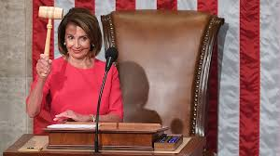
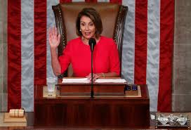
The Speaker’s powers revolve around two primary duties:
1) preside over the House
2) maintain order. The Speaker presides over most sessions of Congress.
No member of the House may speak unless he or she is recognized by the Speaker and given permission to speak.

Slide 37
Other Duties
Other duties include: interprets and applies the rules of the House, refers bills to committees, rules on points of order, puts motions to a vote, and names the members of all select and conference committees.
The Speaker must sign all resolutions and bills passed by the House. The Speaker may vote, but typically only does so in the event of a tie.

Slide 38
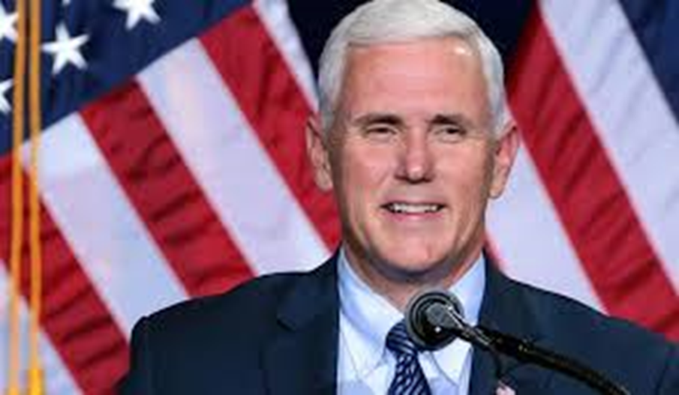
President of the senate
The President of the Senate is always the Vice President of the United States and is the Senate’s presiding officer. Unlike the Speaker of the House, the President of the Senate is not an elected member of Congress and may not even be a member of the majority party in the Senate.
The President of the Senate does have the following powers: recognize members who want to speak, put measures to a vote, and vote ONLY in the event of a tie. In addition, the President of the Senate may NOT debate a bill.
VP Mike Pence

Slide 39
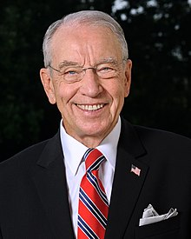
President Pro Tempore
The President Pro Tempore is the presiding officer of the Senate in the Vice President’s absence.
The President Pro Tempore is elected by the members of the Senate and is always a member of the majority party.
Like the Speaker, the President Pro Tempore is typically the longest serving member of the Senate’s majority party.
Chuck Grassley

Slide 40

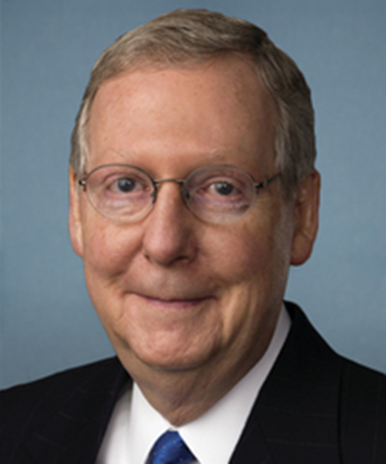
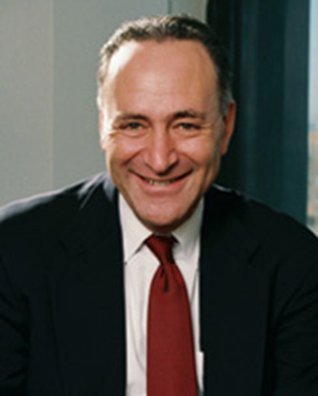
Majority/minority floor leader
Senate Majority Leader Mitch McConnell (R)
Both the House and the Senate have a majority floor leader. They are chosen by party members within their respective houses of Congress from the majority party.
Their role is to carry out decisions of the party caucuses, steer floor action and votes to their party’s advantage, and serve as the chief spokesperson for his or her party.
The minority floor leaders serve the same roles as the majority floor leaders, but they are chosen from the minority party in each house of Congress.
Senate Minority Leader: Charles E. Schumer (D-NY)

Slide 41
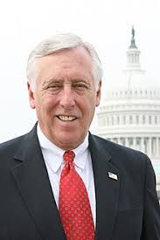
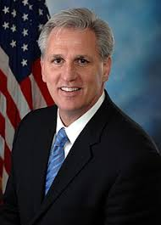
whips
Whips are essentially assistant floor leaders, and both the majority party and the minority party of both the House and the Senate have whips who are appointed by their party colleagues.
Whips in the House:
Steny Hoyer (D) Majority Whip
Kevin McCarthy (R) Minority Whip

Slide 42
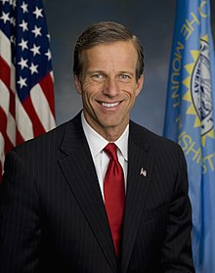

Whips, con’t
The whips are a liaison between the party’s leadership and the other members. The primary duty of the whip is to keep track of the number of votes on measures that are being debated and voted on in both the House and the Senate. The whips also make sure that all party members are present in chambers for votes.
Whips in the Senate
John Thune (R) Majority Whip
Richard Durbin (D) Minority Whip

Slide 43
Congressional committees
Standing committees are permanent committees in the both the House and the Senate. Similar bills are sent to various standing committees. The House and Senate have their own standing committees. The House of Representatives currently has 20 standing committees, and the Senate has 16 standing committees.
Select committees are sometimes referred to as special committees. They are set up for specific purpose and usually for a limited period of time. The Speaker and the President of the Senate assign the members to select committees. Select committees are formed to investigate a current matter.

Slide 44
Congressional committees
Joint committees are composed of members of both the House and the Senate. Some joint committees are select committees and some are permanent.
A conference committee is a temporary, joint committee that is organized to iron out differences in the versions of a bill from the House and the Senate. The final bills from both the House and Senate must be identical before they can be sent on to the President. Once a compromise is reached, the conference committee disbands.

Slide 45
Congressional committees

Slide 46
Credit card Check
Choose a learning target that we have had for the Legislative Branch and provide a response to your I (can) statement.
I can list and explain the formal qualifications for the U.S. Senators and House of Representatives listed in the Constitution.
I can explain the election process for U.S. Senators and House of Representatives.
I can explain the impact of the 17th Amendment on the election process.
I can list and explain the terms of office for the Senate and House of Representatives.
I can describe the similarities and differences of the powers for the Senate and House of Representatives.
I can describe the process for how a bill becomes a law

Slide 47
Legislative Branch
SSCG8: Demonstrate knowledge of the legislative branch of government.
SSCG8g: Analyze the positive and negative role lobbyists play in the legislative process

Slide 48

lobbying
*Lobbying includes the activities by which group pressures are brought to bear on the legislative process and legislators. Lobbyists, those individuals who lobby, are usually connected to special interest groups.
The lobbyists ‘campaign’ to have public policy approved that represents the special interests of the group they work for. For example, the NRA (National Rifle Association) employs lobbyists to persuade legislators to pass bills and enforce public policy that supports their interests in gun control. Companies who manufacture guns, ammunition, and related products obviously want laws that support the second amendment right to bear arms.

Slide 49
Pro’s of Lobbying
There are positive aspects of lobbying. Lobbyists are usually very knowledgeable on the issue they represent. They can educate members of both the House and the Senate on the issues at hand to better inform legislators. Lobbyists represent a much wider group of people who share similar interests and act as the spokesperson for those common interests. Lobbyists can assist legislators in drafting legislation and including accurate, up-to-date information on issues of public policy.

Slide 50
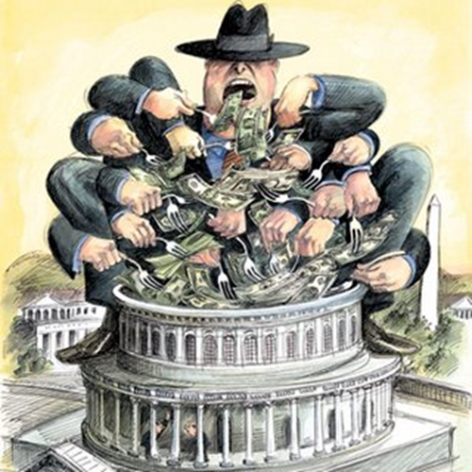
There is often a negative connotation associated with the word lobbyist. In earlier times, lobbying brought forth images of bribery and the use of unethical practices. Regulations have removed the abuses lobbyists used in past legislative processes. One negative aspect of lobbying is that the special interest groups that have the most money are often the groups that have legislation drafted and passed in their favor. There may be important and valid issues that need addressed from a public policy perspective, but if it is grass-roots effort with little money, their interests may go unnoticed at the national and state levels.

Slide 51
