Slide 1
Fall of Rome
SSWH3 Examine the political, philosophical, and cultural interaction of Classical Mediterranean societies from 700 BCE/BC to 400 CE/AD.
f. Analyze the factors that led to the collapse of the Western Roman Empire.

Slide 2
Objectives
Explain the factors that led to the fall of Rome, and be able to identify which factors they feel is most important and support their claim with evidence

Slide 3
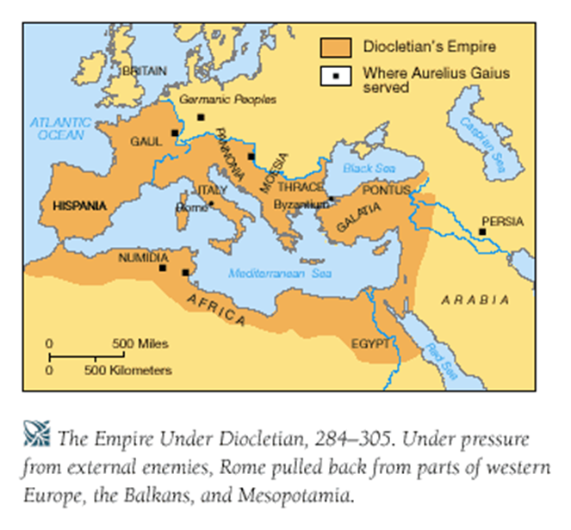
The Roman Empire at its Height
The Roman Empire became huge
It covered most of Europe, North Africa, and some of Asia
The Empire reached its height under Emperor ________ (284-305 CE)
Becomes too large to govern

Slide 4
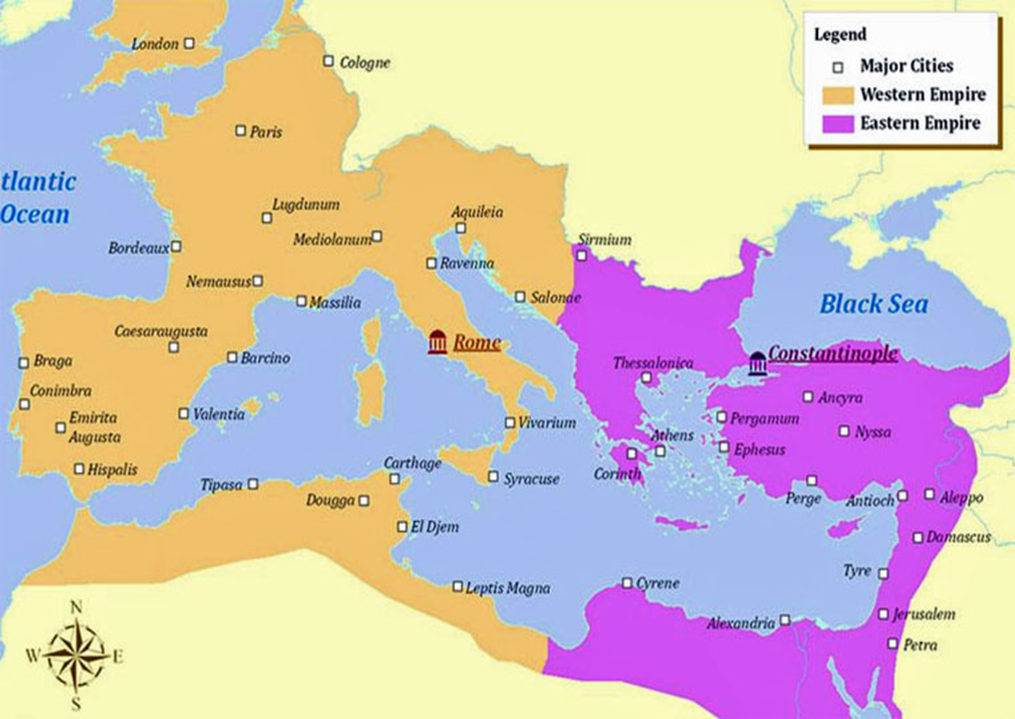
Solution
Split into __ separate empires
Latin Western Empire (Rome): falls in 453AD
Greek Eastern Empire: falls in 1453
East & Western Empire become completely separated in terms of ________ ___ _______

Slide 5
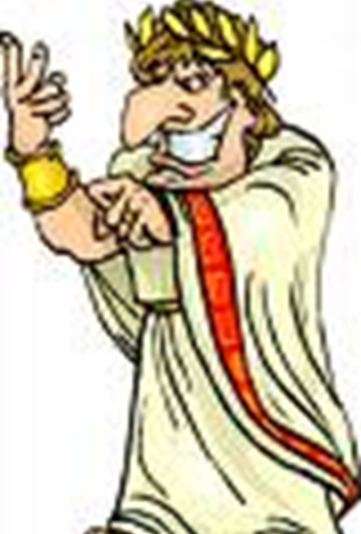
Leadership Issues
____ leaders weakened the government
Frequent fights for power
Many officials took ______
Talented people chose not to serve due to ________ of government life
In the last ____ years of the Western Empire there were 23 Emperors, 20 of which were murdered
https://www.livebinders.com/play/play?id=813820

Slide 6
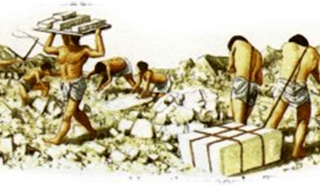
Social Problems
Taxes were too great, many rich people ______ paying
People stopped attending ______
Large number of people ______
_______ (disease) spread throughout Rome, killing 1 in 10
______: There was not enough food to feed people

Slide 7
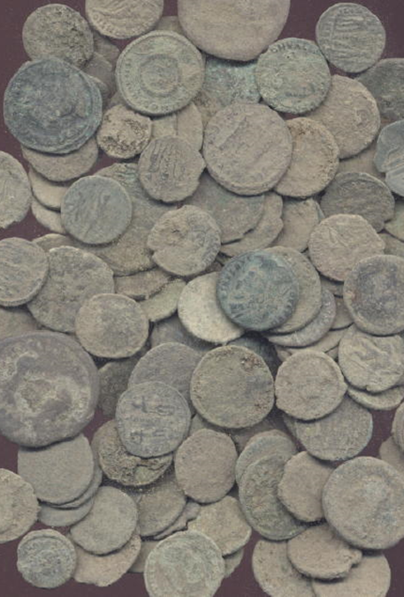
Economic Issues
Government began running out of money to govern such a large empire
How would you fix it?

Slide 8
Economic Issues
SOLUTION: _______ taxation on the poor
SOLUTION: Use slaves.
People were being taxed ____of their income and with the use of slaves some did not have jobs to pay their taxes
With the addition of poor leadership this ignites _____ ____

Slide 9
RISE OF CHRISTIANITY
A huge ________ shift from the “pagan old gods” to Christianity again, ignites civil unrest
Who is the supreme ruler? The Pope or the Emperor?
No one can decide.

Slide 10
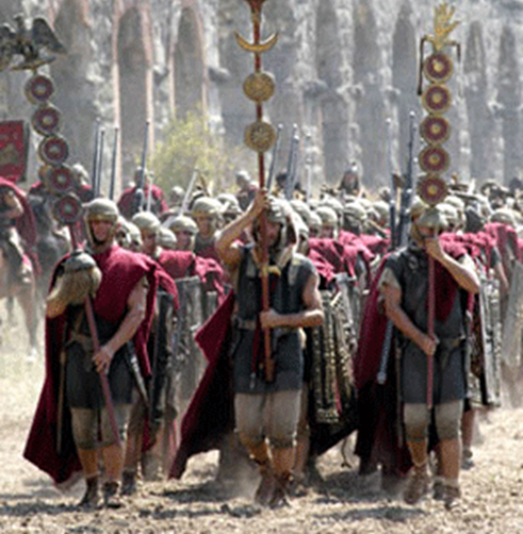
Military Problems
________ only in it for money (mercenaries)
No money to pay military = weak military
Constant threat of _______ on empire’s borders
Weak military, unable to stop border _______

Slide 11
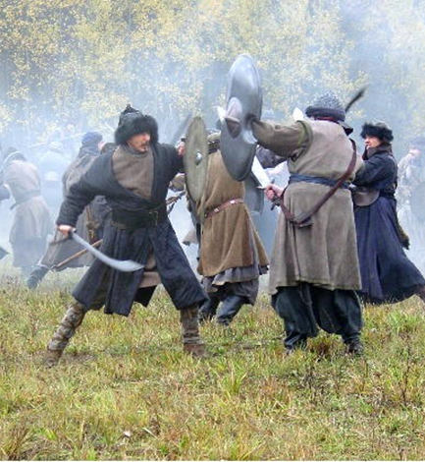
Rome Invaded
Western Empire unable to hold off ______ _____on its borders
Ostrogoths, Visigoths, Franks, Vandals, Saxons
German tribes wanted warmer area, Roman riches, and to flee the _____

Slide 12
Barbarian Invasions

Slide 13
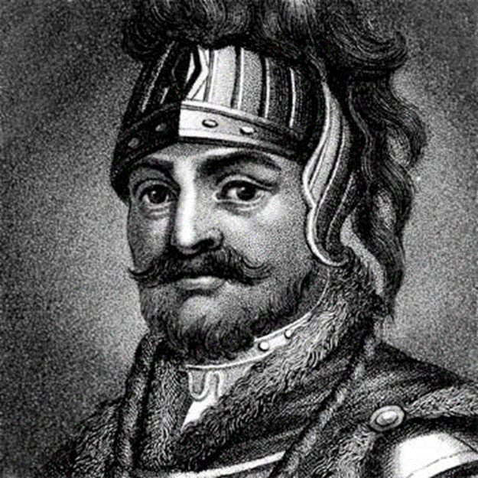
Visigoths
Rome agreed to allow the ________ to live inside of Roman boundaries
Romans treated Visigoths ____
Visigoths _______ and defeated the Romans
Visigoth leader, ______, captured Rome in 410 CE

Slide 14
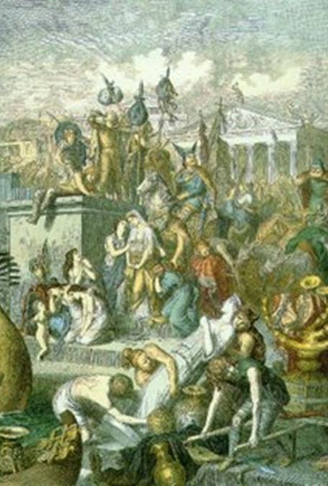
Vandals
Vandals followed Visigoths and spent ___ days stripping Rome of valuables (vandalism)
Many more German invaders followed
Finally, Vandals defeated the western emperor _________ __________

Slide 15
The Fall
Augustulus was defeated in 476 CE
For this reason, this date is given as the fall of the Western Roman Empire
Western Empire was divided into many kingdoms that adopted many of the customs of Rome

Slide 16
WHAT ABOUT THE EAST?
Also Known as the BYZANTINE EMPIRE
Spans from 285 AD – 1453AD
Justinian reconquers parts of Africa & Italy to regain some of the Western Empire in the 6th Century
Capital City of Constantinople
Center of Christianity

Slide 17
Why does the East Fall?
Rise of the Ottoman Empire
Rise of Islam (Crusades)
Arrival of the Selguks
Civil War
Byzantine Empire makes it to 1453 AD (2100)

