Slide 1
RISE OF CHRISTIANITY

Slide 2
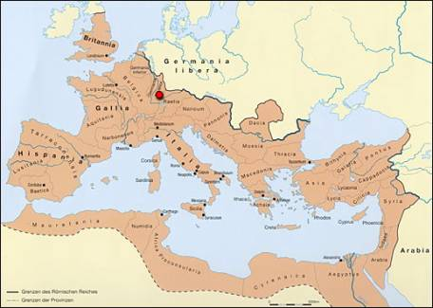
EXPANSION OF ROME
ROME expands all the way to Eastern into Mesopotamia and incorporates Jerusalem
As a result come in contact with a variety of different religions and for the most part are tolerated

Slide 3
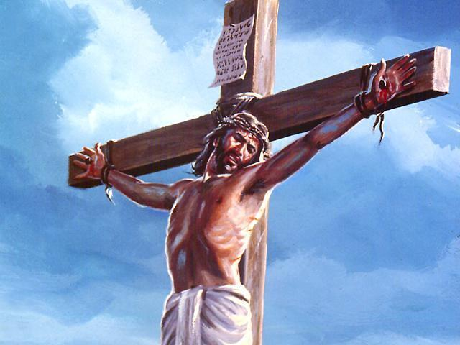
CHRISTIANITY
Starts as a secret society cult religion
30 AD – Jesus of Nazareth is crucified

Slide 4
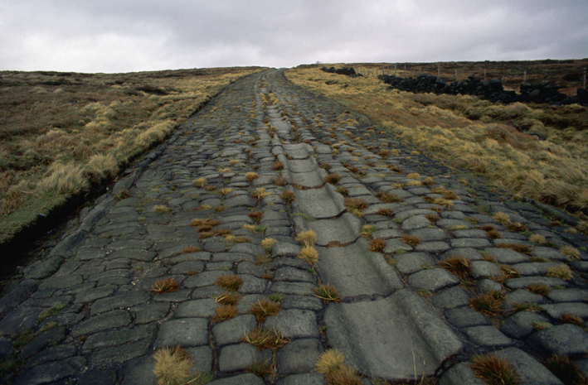
SPREAD OF CHRISTIANITY
10 years after Jesus is crucified – estimated Christians = 1000
The Roman trade routes and roads allowed the message of the Christians to spread easily

Slide 5
Roman Oppression
Romans were not tolerant towards Christians
Christians were used as scapegoats, blamed for social and economic problems
Many Christians became martyrs- or people who suffer or die for their beliefs
However, Christianity continued to spread due to the fact that all people were welcome

Slide 6
CHRISTIANITY GROWS
250 BC
Population of Rome - 60 million
Population of Christians – 1.1million
First churches are held in secrecy in peoples houses
The home is a woman’s domain.
Church is being held in the home.
Roman society is generally discriminatory to women
Christianity gives women a distinct role….

Slide 7
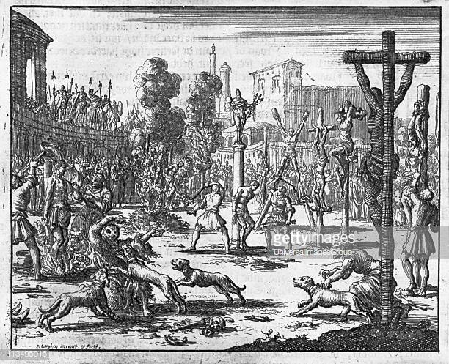
ETHNIC CLEANSING
303 BC – Emperor Diocletian says enough is enough
Becomes furious when he realizes Christians won’t sacrifice to the old gods
Persecutes around 5000 of them outside the Coliseum.
Again they face death with no fear and again the word spreads even further…

Slide 8
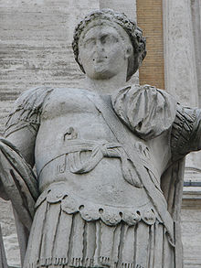
CONSTANTINE THE GREAT
Diocletian separates the Empire into East & West and it was ruled by co-emperors
This doesn’t work and civil war ensues between Constantine & his co-emperors

Slide 9
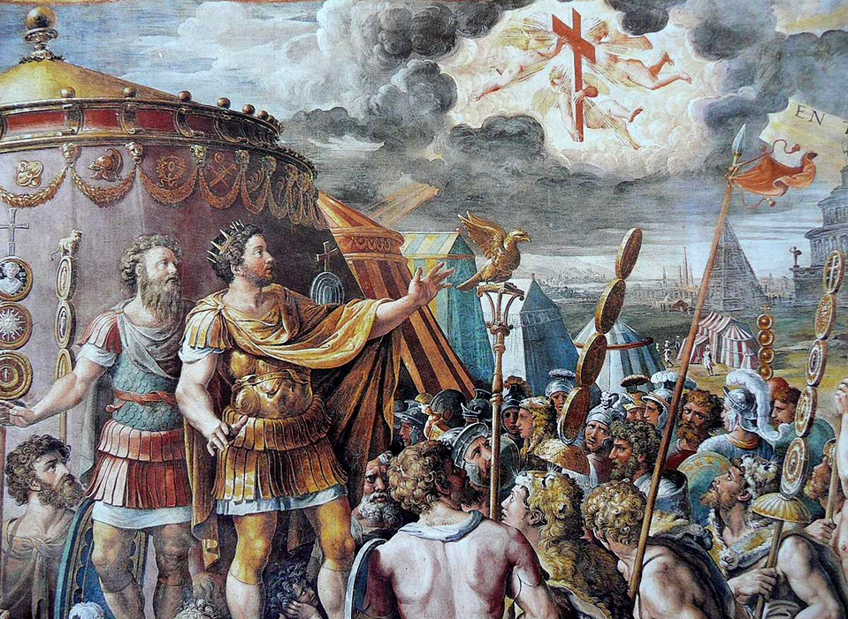
CONSTANTINE THE GREAT
Prior to marching into battle Constantine sees a “sign from god” in the sky
Declares he will fight this Battle in the name of the lord and the Christians.
They win decisively

Slide 10
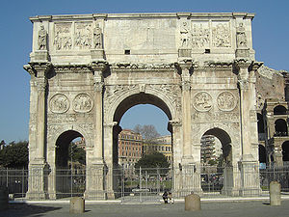
CONSTANTINE THE GREAT
Returns to Rome, institutes policies of religious tolerance
First Emperor to be baptized
The Arch of Constantine in Rome tells the story of this “divine” battle

Slide 11
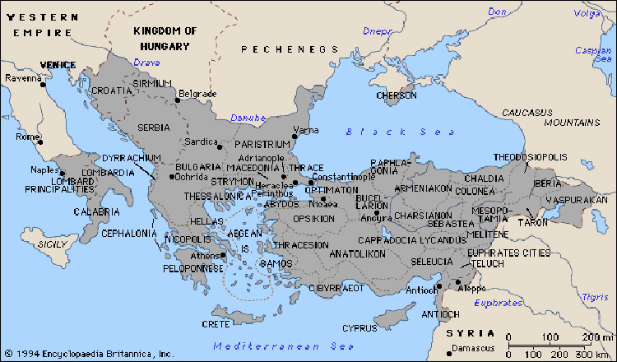
CONSTANTINE THE GREAT
Barbarians continue to invade and pillage the Western Roman Empire
The Eastern Empire is much more secure & “safe”
Constantine founds the city of New Rome in Byzantium
Renamed:
Constantinople in
his honor
Center of Christianity

Slide 12
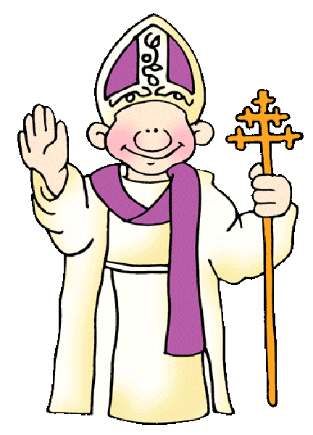
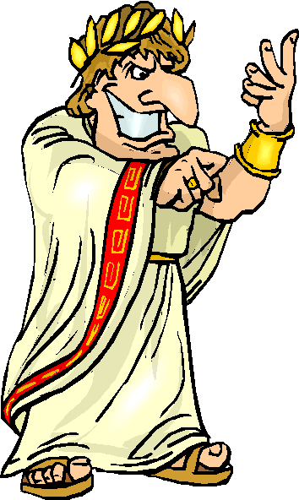
POWER – BEfORE CONSTANTINE
EMPEROR
All religious power
All political power
All judicial power
THE “POPE”
Worried about church matters & that’s about it
The Pope was technically still a subject of the Emperor

Slide 13
POWER DURING Constantine
Constantine gives the Pope Secular Powers
Powers outside of the church (political, legislative)
Christians begin taking over political roles and authority

Slide 14
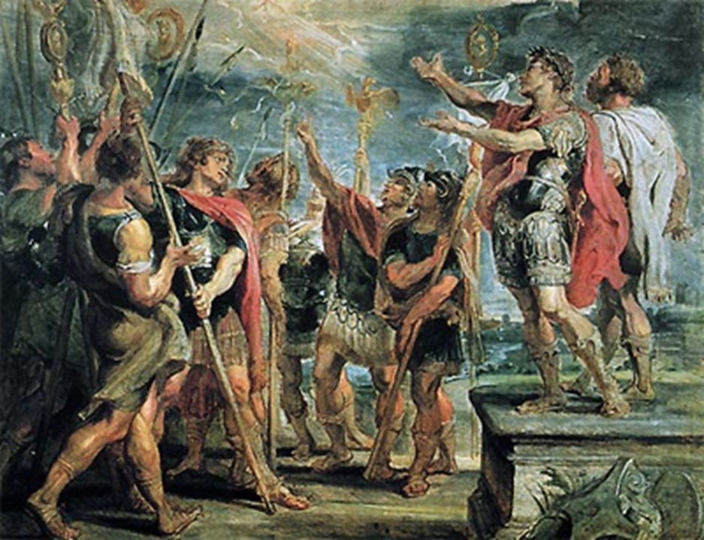
Power After Constantine
Emperor Constantine issued the Edict of Milan in A.D. 313.
The Edict granted freedom of worship to all citizens of the Roman empire
By the end of the century, Emperor Theodosius made Christianity the official religion of the Roman empire

